Slide 1
Amino Acid and Protein Biosynthesis
Announcements:
Today: Shorter Lecture
Anyi Presentation: Vitamin C and Collagen Synthesis
CRLT Midterm Student Feedback

Slide 2
Quiz Question #1
Which amino acid does not depend on the presence of an amino acid precursor for biosynthesis?
Alanine
Asparagine
Tyrosine
Arginine

Slide 3
Quiz Question #2
What is a transamination reaction
The transfer of ammonia to urea for disposal
The removal of an amino group releasing ammonia
The transfer of an amino group from one molecule to another
The removal of an amino group from an amino acid for degradation

Slide 4
Quiz Question #3
Which amino acid cannot be made by adult humans?
Arginine
Leucine
Serine
Aspartate

Slide 5
Concept Mapping: Try to diagram the relationships between these concepts
Essential Amino Acids
Non-Essential Amino Acids
Amino Acid Sensors
GCN2
Leucine, Isoleucine, Valine
mTORC1
Insulin, GH, IGF1
Carbon Skeletons
Arginine, Lysine, Leucine
Protein Synthesis Hormones
Transaminase Reactions
Glutamine/Glutamate Pool
FGF21
Appetite
Negative Feedback Loops
BCAA’s
Amino Acid Pool

Slide 6
Learning Objectives
Understand the mechanistic differences that explain the difference between dispensable and indispensable amino acids.
Evaluate the roles of insulin, growth hormone, testosterone and cortisol on protein synthesis and degradation.
Describe the central roles of glutamate and glutamine as a pool of nitrogen.
Describe the relationships between the glycolytic and TCA cycle intermediates and amino acid biosynthesis.
Explain why some amino acids are dispensable only if precursors are available.
Understand how amino acid biosynthetic rates are controlled by utilization and by negative feedback.
Understand the role that the indispensable amino acids play in controlling protein synthesis.

Slide 7
TCA Cycle and Amino Acid Biosynthesis
PH
Many amino acids are derived from glycolytic and TCA intermediates
3-Phosphoglycerate
Pyruvate
Oxaloacetate
α-Ketoglutarate
Notes:
A caveat about your biochemistry textbooks

Slide 8
Two Kinds of Amino Acid Biosynthetic Reactions
Single Step (Transaminase)
Multiple Step
Fast and Bioenergetically neutral
Controlled by Supply and Demand
Ala, Asp, Glu
Committed steps
Controlled by Feedback Inhibition
Ser, Cys, Gly, Asn, Pro, Arg, His

Slide 9
Feedback Inhibition of Multi-step Processes
-
Serine
Cysteine

Slide 10
Transamination Reactions Allow for Rapid Exchange of Amino Groups to Balance Amino Acids

Slide 11
Reversible Transaminase Reactions Allow for Rapid Exchange of Amino Acids
Substrates |  | Enzyme | Products
Pyruvate | Glutamate | ALT | Alanine | α-Ketoglutarate
Oxaloacetate | Glutamate | AST | Aspartate | α-Ketoglutarate

Slide 12
Supply and demand controls the levels of the amino acids from the transaminase reactions
Driving towards Alanine
Driving towards Pyruvate
What would increase supply?
What would cause demand?
What would increase supply?
What would cause demand?

Slide 13
Glutamate and Glutamine Buffer the Nitrogen Pool
10 of the 11 biosynthetic reactions involve glutamate
Alanine – from Pyruvate/Glutamate
Aspartate – from Oxaloacetate/Glutamate
Serine – from 3-Phosphoglycerate/Glutamate
Cysteine – From Serine
Glycine – From Serine
Downstream of Glutamate
Proline
Glutamine
Arginine
Histidine
Not Tyrosine (Phenylalanine hydroxylase)
Notes:
What does this mean for conditionally essentiality?
MSG

Slide 14
Regulation of Glutamate Dehydrogenase
Tends to Make αKG by
ADP, GDP
BCAA and their metabolites
NAD
Tends to Make Glu by
αKG
NADPH
ATP, GTP
Ammonia

Slide 15
Where is Glutamate Generated From?
Supply from transaminase reactions (i.e. Alanine/Aspartate)
Deamination of glutamine by glutaminase

Slide 16
Glutamine levels vs other amino acids in tissues

Slide 17
What are some properties of glutamine that make it a good storage pool for nitrogen?

Slide 18
Vitamin C and Collagen Stability
Anyi Liu
NUTR630

Slide 19
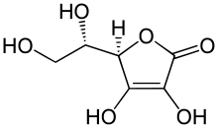
Vitamin C Structure and Function
Water-soluble: can’t store or synthesize it
Has to be obtained from food
Antioxidant
Growth and repair of tissues
Collagen synthesis
Healing wounds
Repair and maintaining teeth and bones
Help absorb irons
Prevent some chronic diseases
Immune system
Notes:
Vitamin C is water-soluble, body can’t store it. So it has to be obtained from foods like citrus fruits, broccoli and tomatoes.
Heart disease, HBP, common cold, cancer, osteoarthritis, asthma, etc.

Slide 20
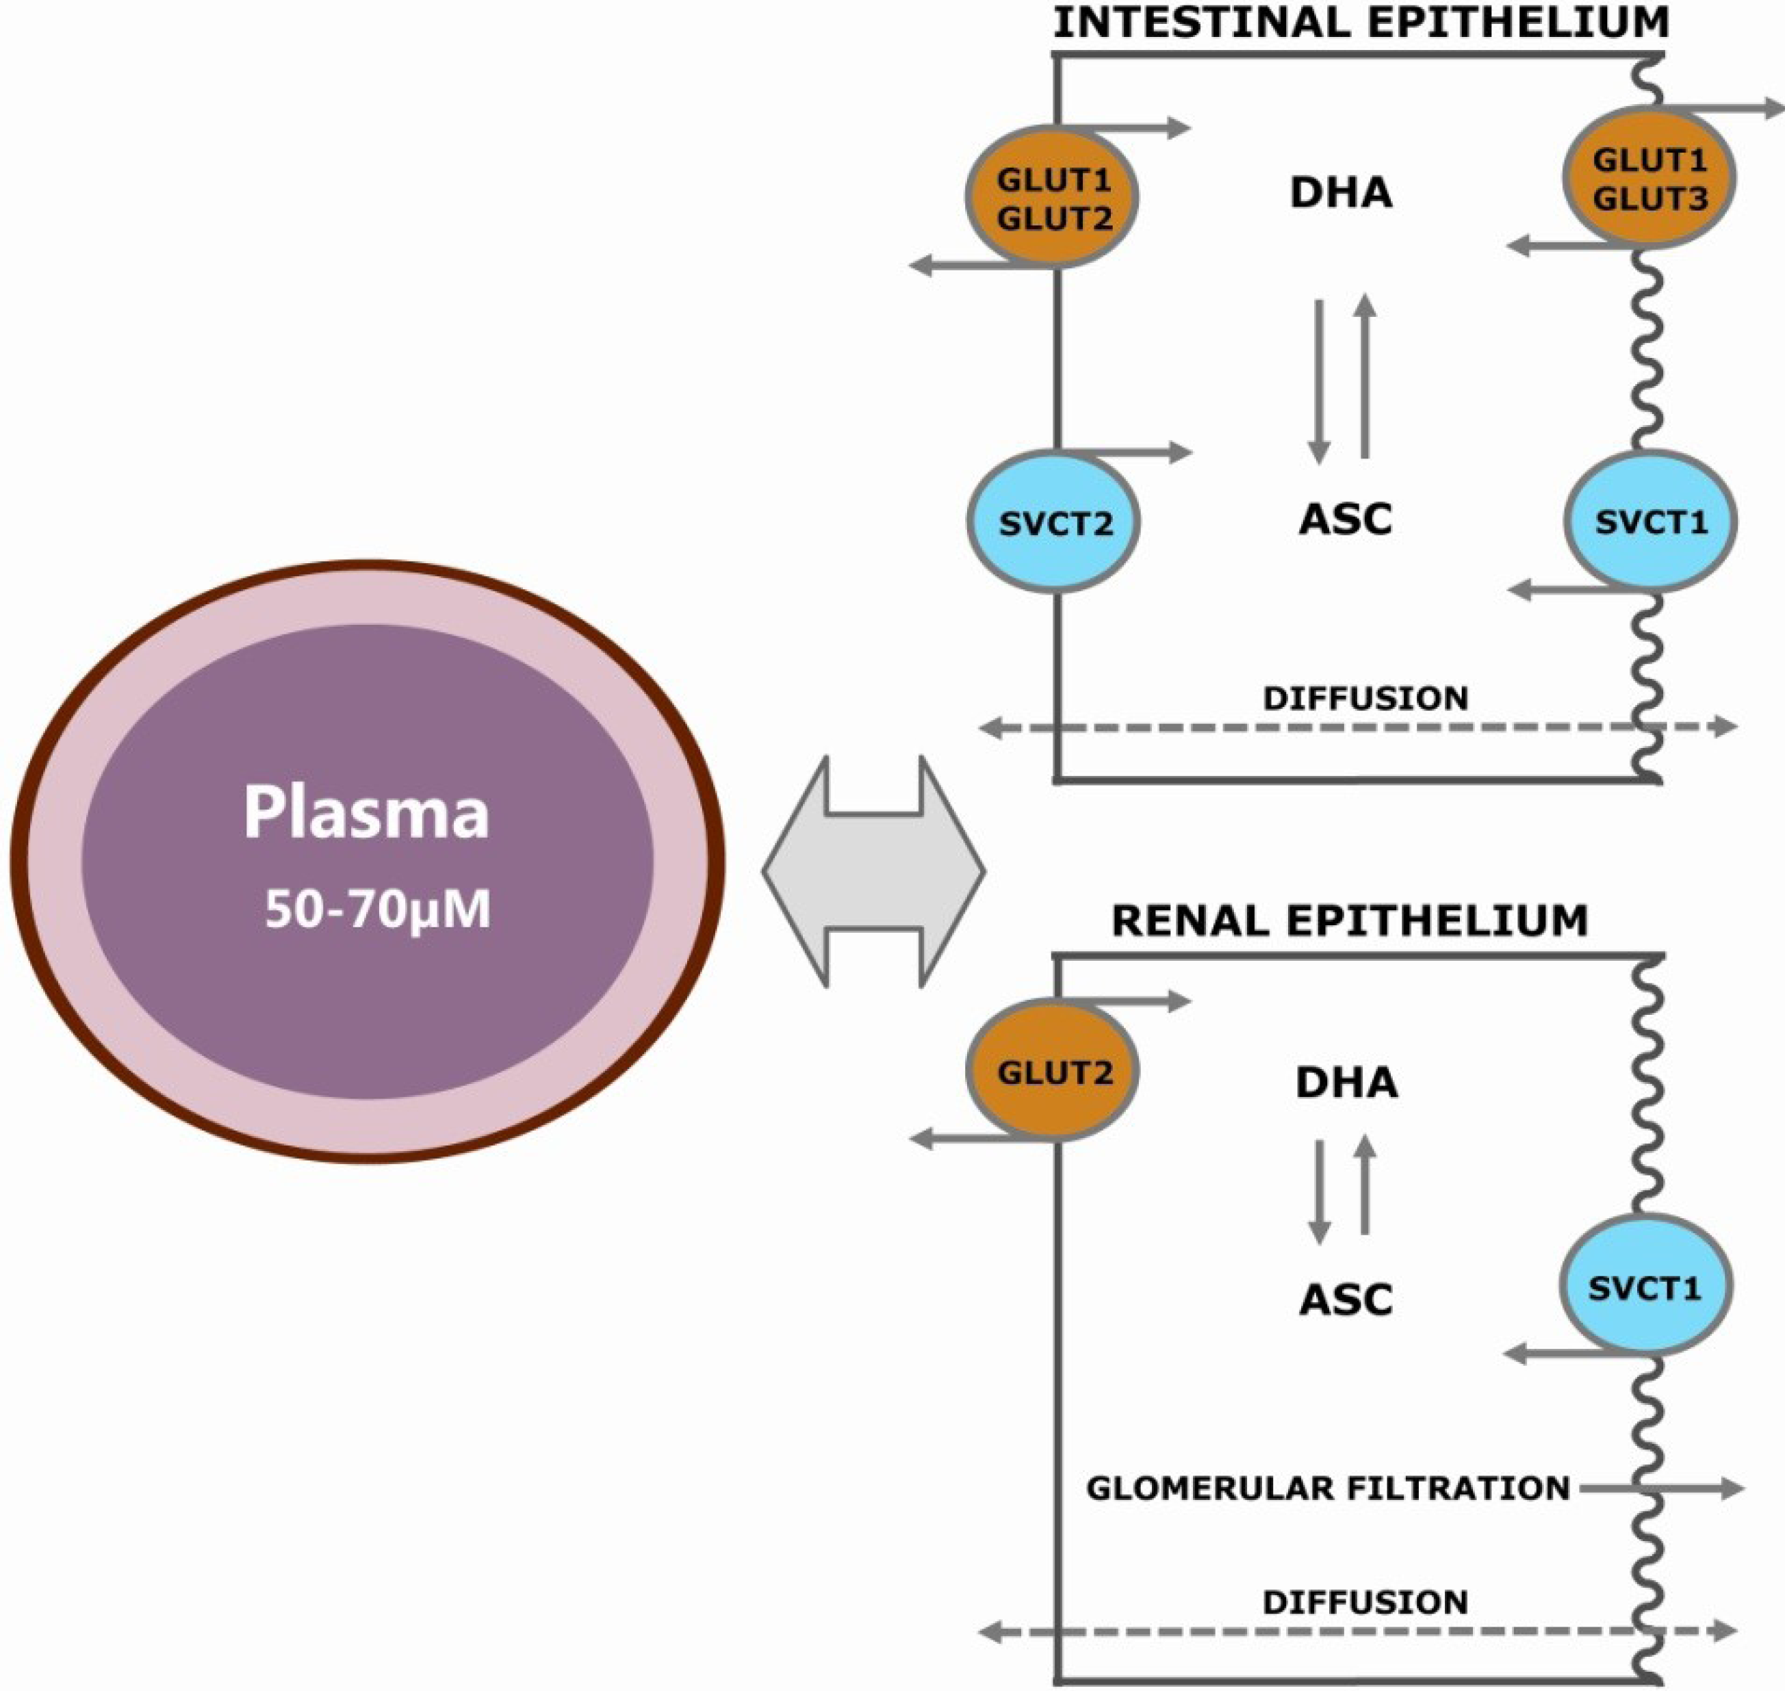
Digestion and Absorption of Vc
No need to be digested prior to absorption
Both active transport and simple diffusion:
Sodium-Dependent Active Transport: Sodium-Ascorbate Cotransporter
Glucose transporters (GLUTs)
The absorption capacity is inversely related to intake

Slide 21
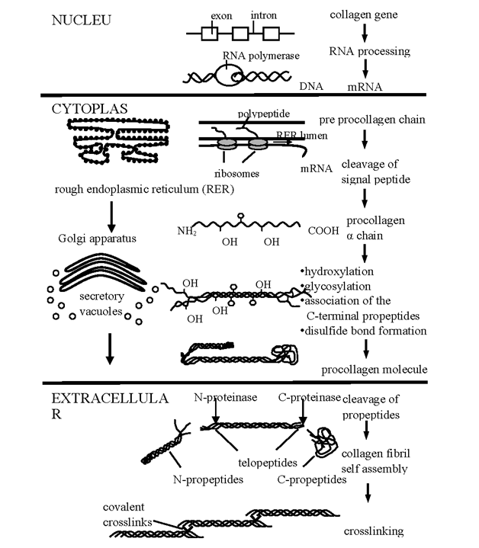

Collagen Synthesis
Assembly of pro-alpha chains (directed by mRNA)
Proline Hydroxylation
Lysine Hydroxylation
Hydroxylysine Glycosylation
Disulphide bond formation of C terminal propeptide

Slide 22
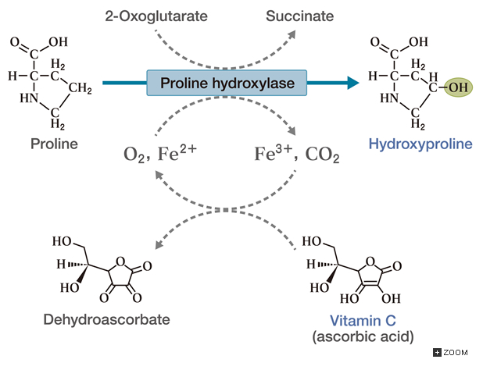
The Role in Collagen Stability
Vitamin C is a cofactor:
Prolyl and Lysyl hydroxylase

Slide 23
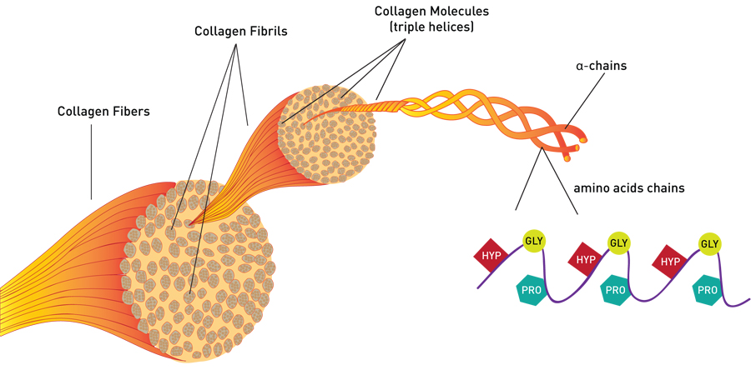
Collagen Structure
Notes:
Collagen is the most abundant structural protein in all animals. It comprises 1/3 of the total protein, 3/4 of the dry weight of skin and is the most prevalent component of the extracellular matrix.

Slide 24
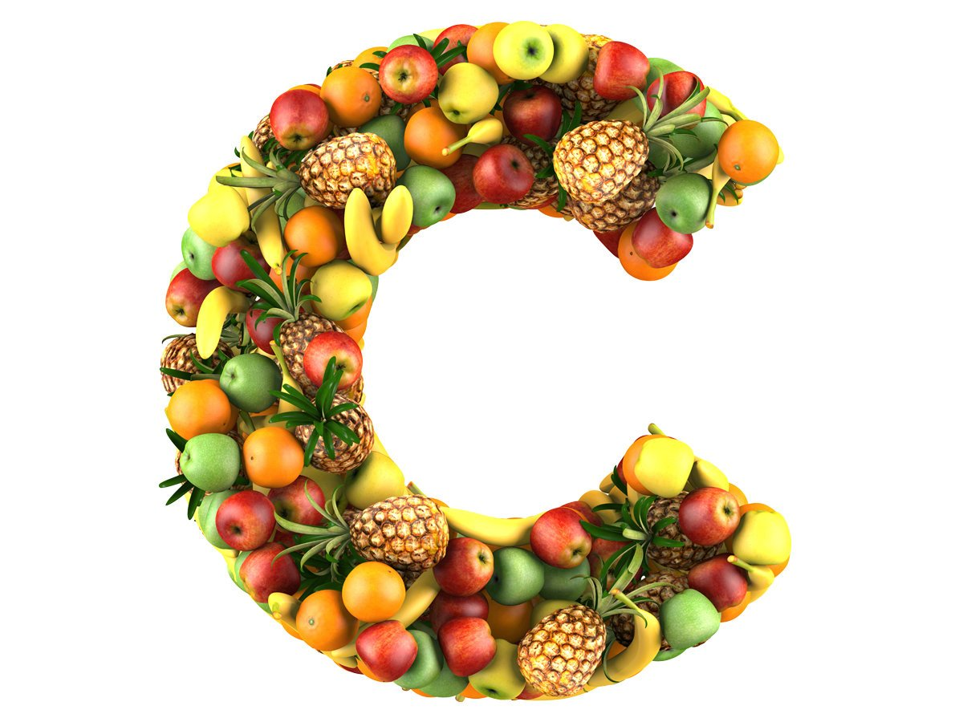
Vitamin C Deficiency
Rare, but many people have low level of Vc
Symptoms:
Dry and splitting hair
Gingivitis and bleeding gums
Rough, dry and scaly skin
Nose bleeding
Severe form: scurvy
Notes:
Digestion and absorption of Vc

Slide 25
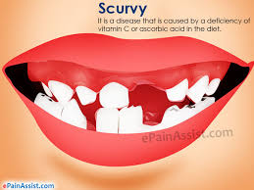
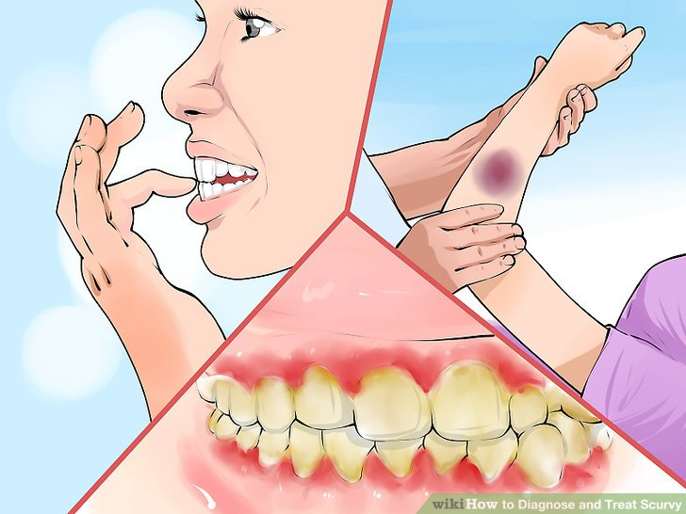
Scurvy Symptoms
Loose teeth
Easy bruising
Gums prone to bleeding
Poor wounds healing

Slide 26
Treatments & Prevention
Vitamin C supplement by mouth
Adults dose is 800-1000mg per day for at least 1 week, and then 400mg per day until complete recovery
More fruits and vegetables intake
Limes, oranges, lemons, grapefruits, etc.

Slide 27
References:
http://www.umm.edu/health/medical/altmed/supplement/vitamin-c-ascorbic-acid
http://www.namrata.co/collagen-synthesistypes-and-composition-part-2/steps-of-collagen-synthesis/
https://www.proto-col.com/blog/2014/07/collagen/
http://onlinelibrary.wiley.com/doi/10.1046/j.1467-2494.1998.171747.x/abstract;jsessionid=181C02FCCDED3D9B9BA12DA48BF968A7.f02t03
http://nutritionfactors.com/factor/detail/vitamin-c-absorption-and-digestion

Slide 28
Regulation of Protein Biosynthesis

Slide 29
What happens if amino acids are unavailable
Protein synthesis will stall if both essential and non-essential amino acids are not sufficiently available
Therefore the cell needs to be able to detect essential AA levels and respond to them

Slide 30
Two main regulators of protein synthesis
When nutrients are high
When amino acids are low
mTORC1 active (+)
GCN2 inactive (-)
Protein synthesis
Ribosome biogenesis
Stops protein breakdown
mTORC1 inactive (-)
GCN2 inactive (+)
Protein breakdown
Stops protein synthesis
FGF21

Slide 31
mTORC1 Senses Some of the Essential Amino Acids
Activated by several signals:
Essential Amino Acids
Arginine
Lysine
Leucine
Insulin
Energy Levels (via AMPK)

Slide 32
mTORC1 Activity Leads to More Protein Synthesis
Amino Acids

Slide 33
Hormonal Regulation of Protein Synthesis
Hormone | Effects on Protein Synthesis | Effects on Protein Degradation
Insulin | Promotes | Blocks
Glucocorticoids | Blocks | Promotes
Growth Hormone/IGF1 | Promotes | Blocks
Testosterone | Promotes | Blocks

Slide 34
Energy Costs of Protein Production
For every peptide bond you need 4 ATP equivalents
Actin has 374 amino acids
How many molecules of glucose are needed to make Actin’s peptide bonds
If only glycolysis (8 ATP/glucose)
If glycolysis/TCA/ETC (36 ATP/glucose)
Step | Cost
Making Amino–Acyl tRNA | 2 ATP bonds ATP -> ADP ->AMP
Binding of tRNA | 1 GTP
Elongation | 1 GTP

Slide 35
Neuroendocrine Control of Protein Levels
In humans, if essential amino acids are lacking what can be done?
Breakdown of proteins?
Synthesis of all amino acids?
Increased ingestion of amino acids
How does this relate to why protein is such a strong satiating signal?

Slide 36
Learning Objectives
Understand the mechanistic differences that explain the difference between dispensable and indispensable amino acids.
Describe the central role of glutamate as a pool of nitrogen.
Describe the relationships between the glycolytic and TCA cycle intermediates and amino acid biosynthesis.
Explain why cysteine and tyrosine are dispensable only if precursors are available.
Understand how amino acid biosynthetic rates are controlled by utilization and by negative feedback.
Understand the role that the indispensable amino acids play in controlling protein synthesis.

